Slide 1


Real time traffic accident analysis based on tweets
Name:

Slide 2
Introduction
Real time traffic accident analysis based on tweets
We used tweepy library to query real time tweet with given parameter (location/ hashtag)
Tweepy is a library monitoring for tweets. We made a custom StreamListener object, which monitors tweets in real time and catches them and publish the these tweet to kafka in real time. With different given parameter such as location and hashtag. For each given location, we can filter the query result with their corresponding geo location.

Slide 3
Introduction
Real time traffic accident analysis based on tweets
We trained and built the the offline model with Naivebayes on the given training data. The model will predict four different accident labels. No, Fire, Shooting and Crash.
The spark streaming process used the pipelined model which consists of StringIndexer, RegexTokenizer, StopWordsRemover, HashingTF, IDF and RandomForestClassifier processes to make prediction on incoming tweets from kafka.
Then the real time incoming tweet are predicted with this trained pipelined model, and the prediction and location are saved at the elasticsearch, which later on be visualized via kibana.

Slide 4
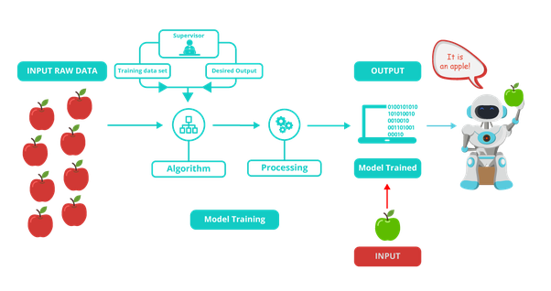
Offline Training model
Model Training
https://www.google.com/url?sa=i&url=https%3A%2F%2Fwww.i2tutorials.com%2Ftop-machine-learning-interview-questions-and-answers%2Fwhat-are-the-differences-between-supervised-machine-learning-and-unsupervised-machine-learning%2F&psig=AOvVaw0KlqTp--NpSnIaOLP1ykZ6&ust=1575837937456000&source=images&cd=vfe&ved=0CAIQjRxqFwoTCLjwwYO0pOYCFQAAAAAdAAAAABAj

Slide 5
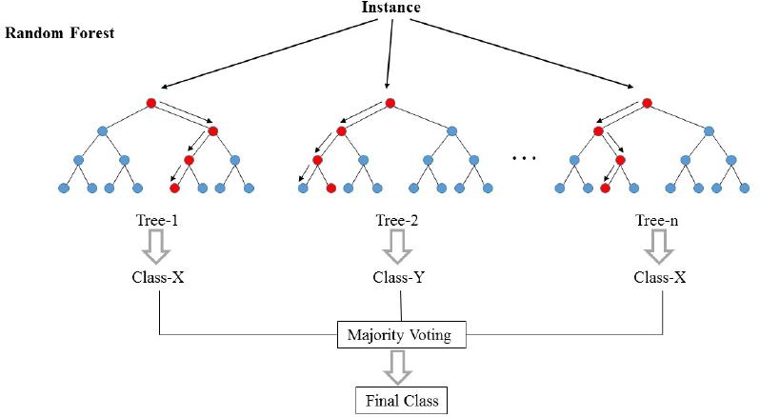
Random forest
Model Selection
In short, the random forest is several Decision Trees combined.
The samples are drawn with replacement, known as bootstrapping, which means that some samples will be used multiple times in a single tree.
Although each decision tree would have high variances, the overall forest low variance and at the same time keep low bias.
https://i.stack.imgur.com/iY55n.jpg

Slide 6
Preprocess
 | StringIndexer | RegexTokenizer | StopWordsRemover | HashingTF | Inverse Document Frequency (IDF)
Definition | Translate all the String classification to numeric | extracts tokens by matching the regex (Set Gap= False) | drops all the stop words from the input sequences | takes sets of terms and converts those sets into fixed-length feature vectors | rescale the feature vectors
Example | No:0,Crash:1,Fire:2,Shooting:3
Input | Crash | This is a text block where you can tab across and add copy | [take, route, 213, to, avoid, traffic, get, stuck, in, traffic, anyway, solution, drive, off, bridge, now, no, more, traffic, ever, again] | [take, route, 213, avoid, traffic, get, stuck, traffic, anyway, solution, drive, bridge, traffic, ever] | (200,[4,23,55,80,103,109,124,148,159,177,181,194],[3.0,1.0,1.0,1.0,1.0,1.0,1.0,1.0,1.0,1.0,1.0,1.0])
Output | 1 | [take, route, 213, to, avoid, traffic, get, stuck, in, traffic, anyway, solution, drive, off, bridge, now, no, more, traffic, ever, again] | [take, route, 213, avoid, traffic, get, stuck, traffic, anyway, solution, drive, bridge, traffic, ever] | (200,[4,23,55,80,103,109,124,148,159,177,181,194],[3.0,1.0,1.0,1.0,1.0,1.0,1.0,1.0,1.0,1.0,1.0,1.0]) | (200,[4,23,55,80,103,109,124,148,159,177,181,194],[7.1,3.2,2.7,3.1,2.7,3.3,3.2,2.6,2.5,3.2,3.2,3.0])
Footer information
Notes:
StringIndexer, RegexTokenizer, StopWordsRemover

Slide 7
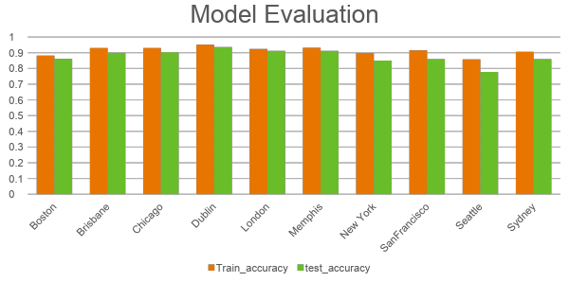
We split the dataset to 70% for training and 30% For testing and come out with accuracy for evaluation.

Slide 8
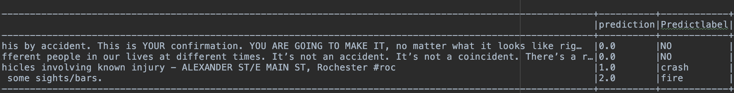
Streaming real-time model
Structure
For each RDD,
We predict the result of classification of the Tweeter
Footer information

Slide 9
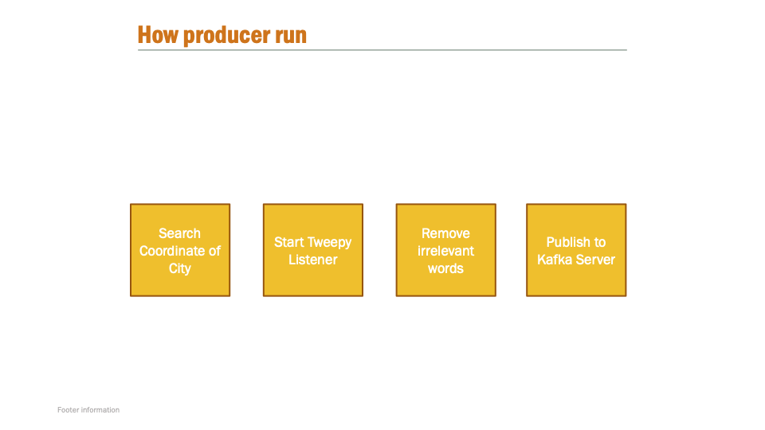

Slide 10
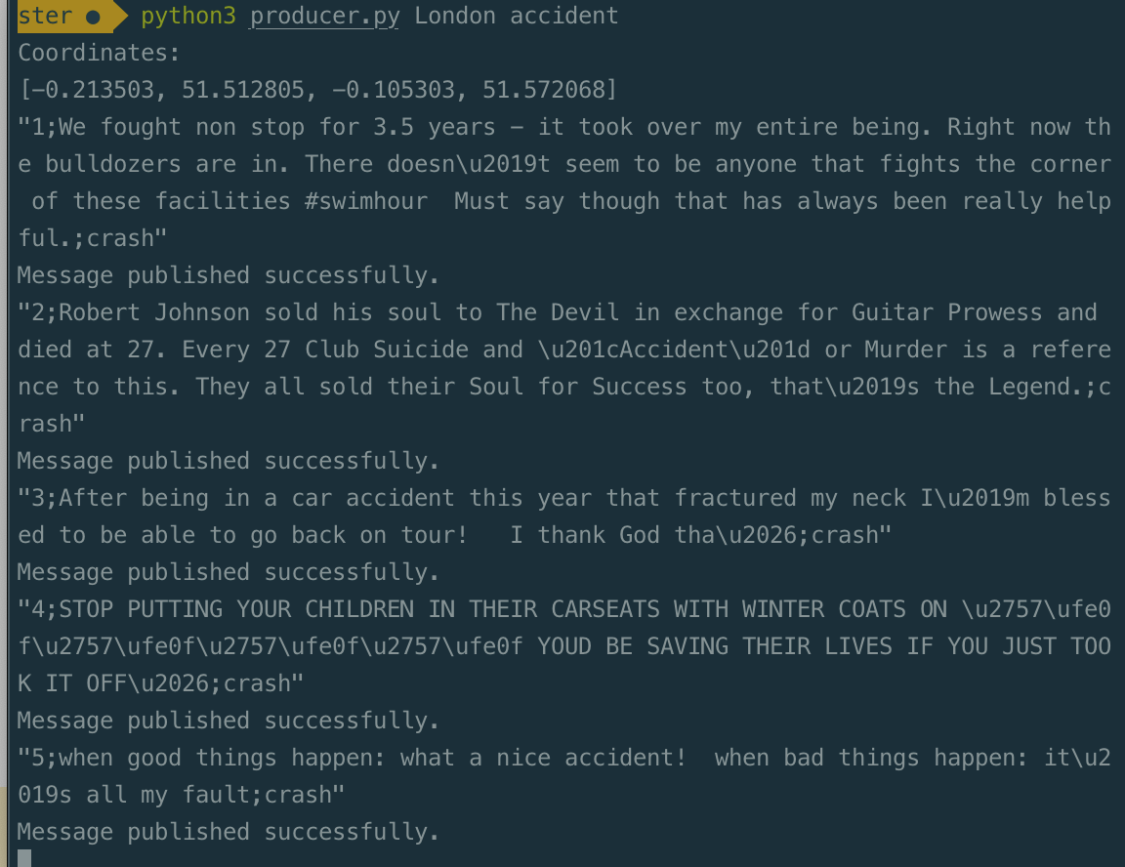
Producer
Get Data
Call tweepy API to get the coordinate of city(southwestern and Northeastern)
Remove all the RT @ , @, and url which are not relevant.
Pass in two parameters : city and hash_tag

Slide 11
The predicted label generated by the ml model and location of the tweets are stored at Elasticsearch, which is a full-text search and analytics engine.
One advantage of using elasticsearch is that it can seamlessly work with
Kibana, is an open source data visualization dashboard for Elasticsearch
We created elasticsearch index first, index the data. Then on Kibana, we created corresponding index patterns, then filtered out the tweets for each city and create corresponding pie chart to show the distribution of the different cases for each city.
Visualization

Slide 12
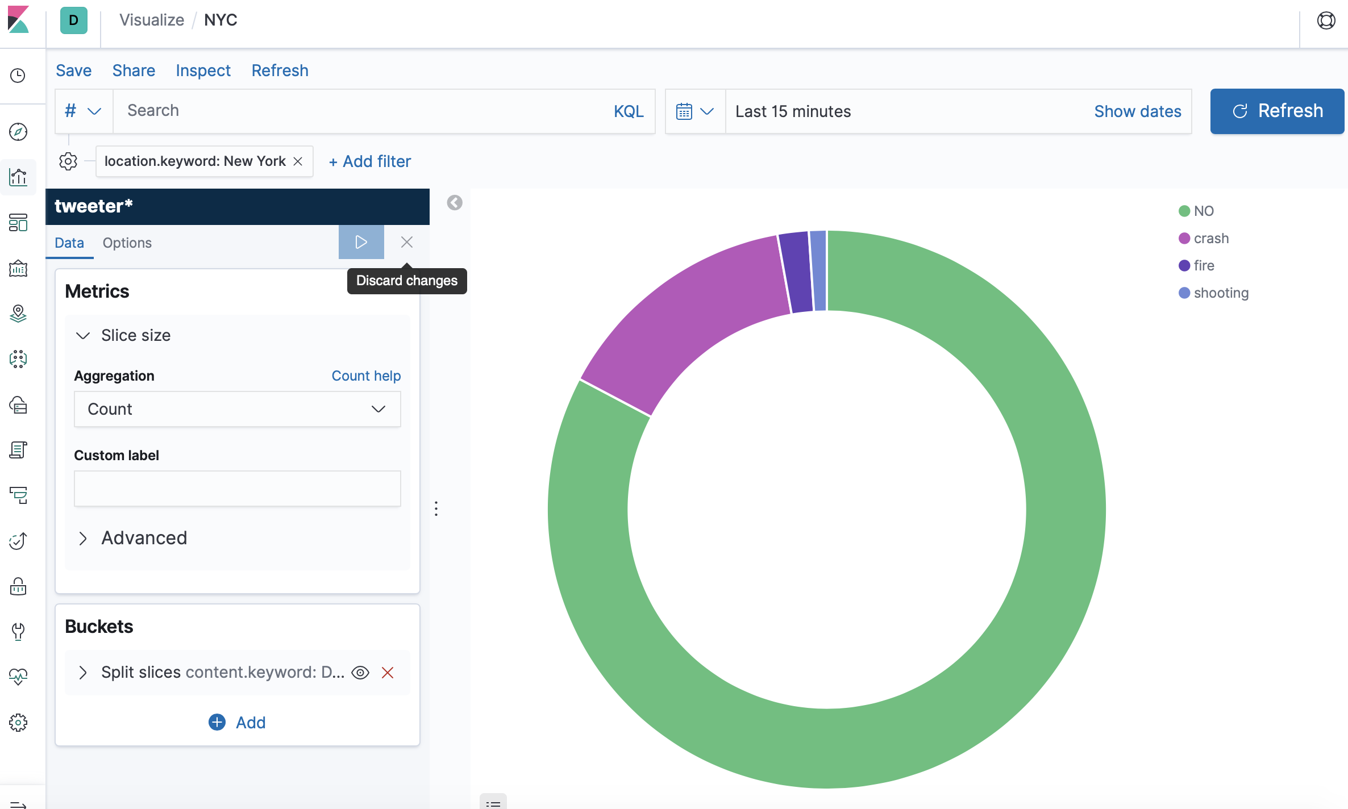
Sample Pie chart for each city

Slide 13
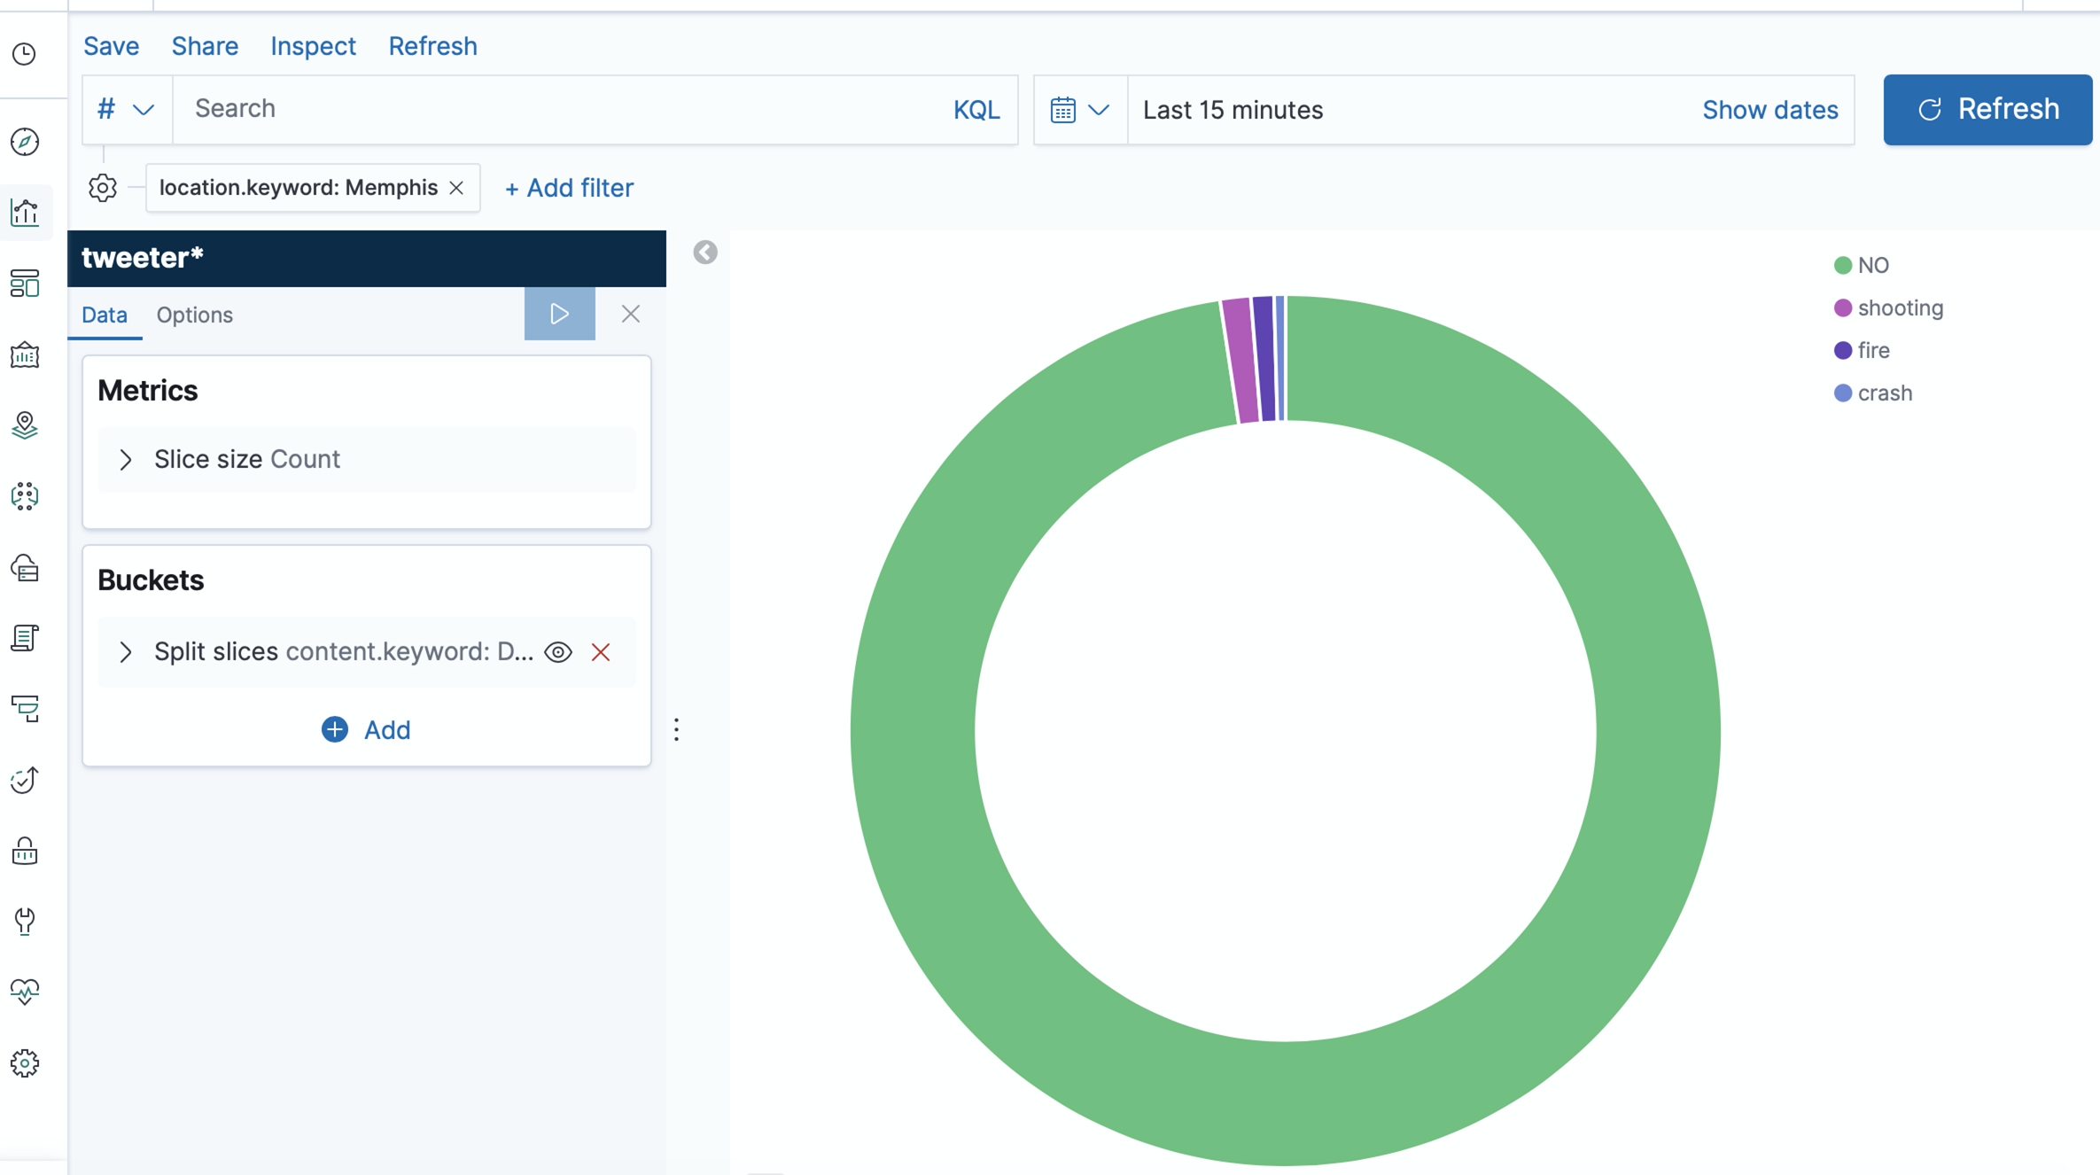
Sample Pie chart for each city

Slide 14

Thank you

